Slide 1
An Overview of Java- Chapter 2
Anika Anwar
Lecturer of CSE Dept

Slide 2
Java Lineage
Related to C++, which is direct descendant of C
Syntax derived from C and maybe object oriented features influenced by C++
WHY JAVA?

Slide 3
Programming Paradigm
All programs consist of two elements: code and data
Some are code dependent→ Process Oriented Programming
Example: C
Some are data dependent→ Object Oriented Programming
Example: Java

Slide 4
Platforms
Programming languages can be platform dependent or independent.
What is platform? Platform means the different types of computer that we use. For example :
Windows
Mac (Apple)
Linux
C, C++, Java, Python works on all these platforms
C# works only on Windows
Objective C programs works only on Mac

Slide 5
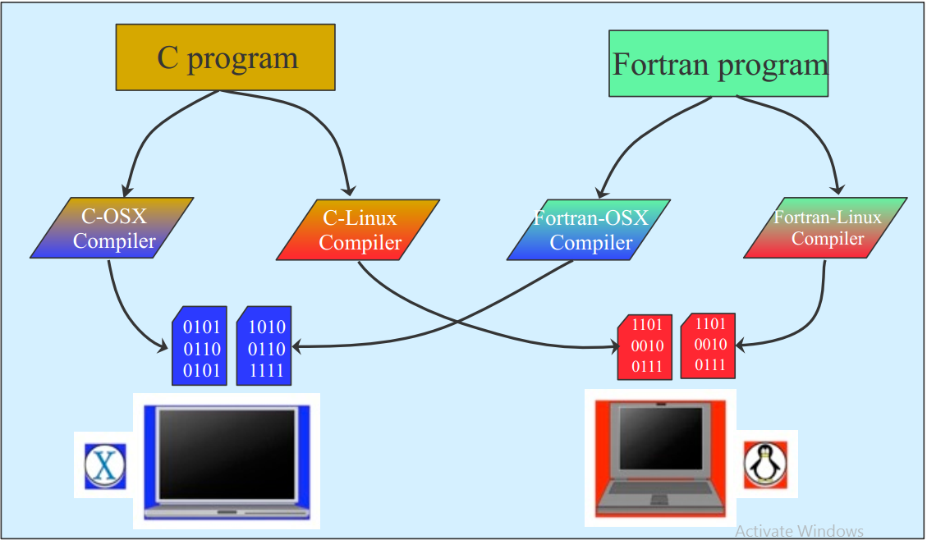
Regular Programming Languages

Slide 6
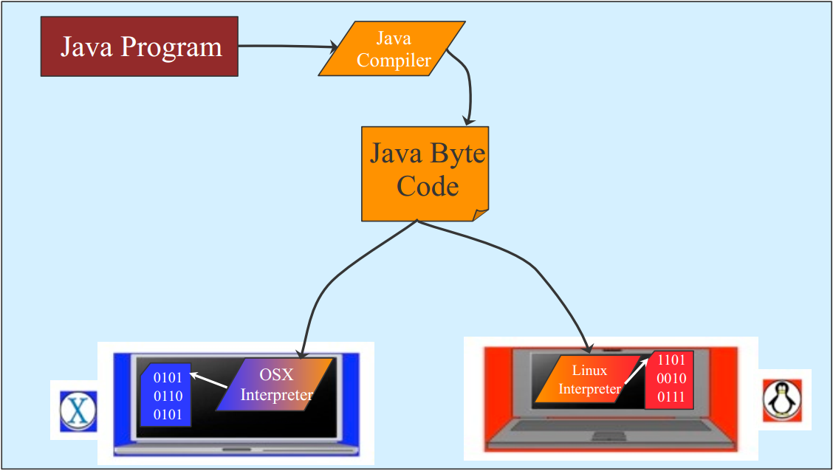
Java

Slide 7
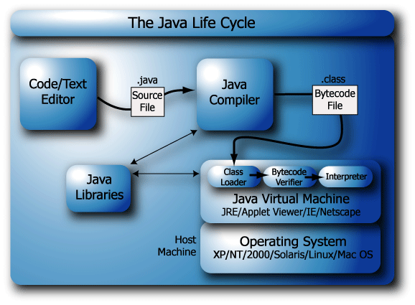

Slide 8
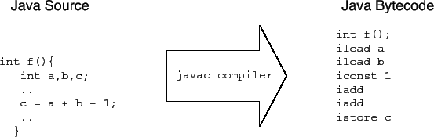
1. What is byte code?
Java bytecode is the instruction set of the Java virtual machine. Each bytecode is composed by one, or in some cases two, bytes that represent the instruction (opcode), along with zero or more bytes for passing parameters

Slide 9
JVM
JVM (Java Virtual Machine) is an abstract machine. It is a specification that provides runtime environment in which java bytecode can be executed.
JVMs are available for many hardware and software platforms. JVM, JRE and JDK are platform dependent because configuration of each OS differs. But, Java is platform independent.
The JVM performs following main tasks:
Loads code
Verifies code
Executes code
Provides runtime environment

Slide 10
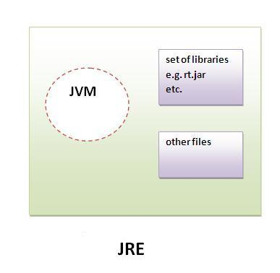
JRE
JRE is an acronym for Java Runtime Environment.
It is used to provide runtime environment.
It is the implementation of JVM.
It physically exists. It contains set of libraries + other files that JVM uses at runtime.

Slide 11
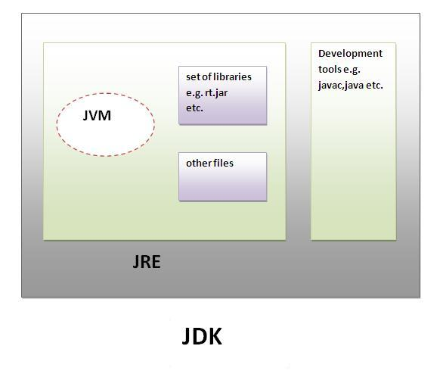
JDK
JDK is an acronym for Java Development Kit.
It physically exists.
It contains JRE + development tools

Slide 12
Platform-Independence
Notion of a “Java Virtual Machine” (JVM)
Java programs are compiled to run on a virtual machine (just a specification of a machine). This code is called Byte Code
Each physical machine that runs a Java program (byte code) must “pretend” to be a JVM.
This is achieved by running a program on the machine that implements the JVM and interprets the byte code to the appropriate machine code.
This interpreting is done at run-time which can cause a slow down!

Slide 13
What is Object
Software objects model real world objects or abstract concepts
Dog , BankAccount
Real world objects have states or behavior
Dog’s State: Name, color, age
Behavior: Barking, Fetching, Sleeping
How do software objects implement real world object?
Use variables/data to implement state.
Use methods/Functions to implement behavior.
An object is a software bundle of variables and related methods

Slide 14
What is Class
Class provide structure for objects
Define their prototype
Classes define:
Set of attributes
Also called state
Represents by variable
Behavior
Represented by methods
Class define data and method associated with an object

Slide 15
Class and Object
Creating an object from a class is called instantiation.
An object is a concrete instance of a particular class
A class is a template for the objects.
Most programs will have multiple classes and objects. Example:
Class : Account
Objects: Peter’s Account, John’s Account
Class Name
Attributes
BankAccount
+Name
+CurrentBalance
+Deposit()
+Withdraw()
Methods

Slide 16
Banking Example
In a banking application, there may be numerous accounts.
There is common behavior (as far as the bank is concerned) for all these accounts " Deposit, Check balance, Withdraw, Overdraw? ...
There are also common types of data of interest " Account holder’s name(s), SSN, Current balance, …
Instead of defining these data and behavior for each account separately, we simple define them once -- this is the notion of the Account class.
Each account will be an instance of this class and will have its own values for the data items, but the same behavior (defined once).

Slide 17
Class and Object
Object Name
Class Name
Peter’s Account
Attributes
+Peter Smith
+$1000
+Deposit()
+Withdraw()
BankAccount
+Name
+ CurrentBalance
+Deposit()
+Withdraw()
Methods

Slide 18
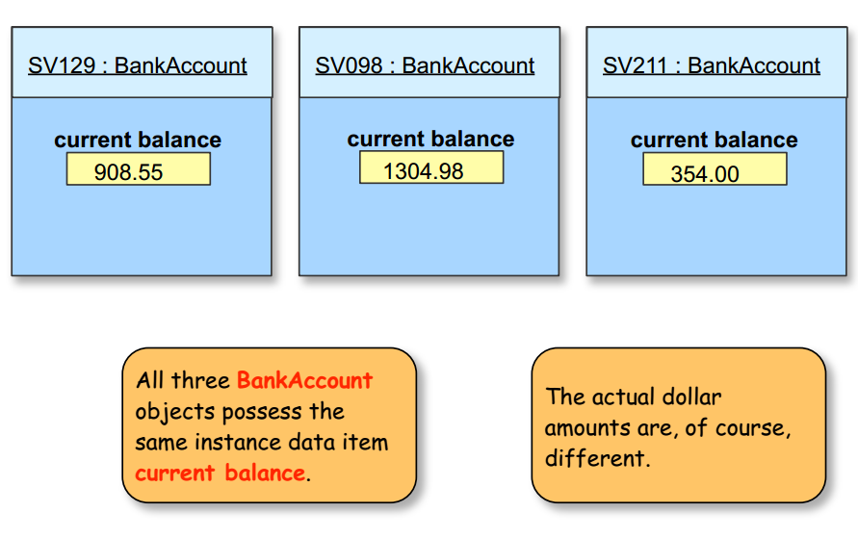
Instance Data Value

Slide 19
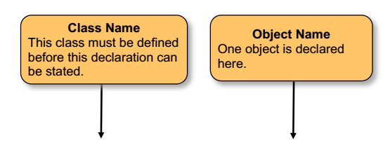
Object Declaration
BankAccount BA1;

Slide 20
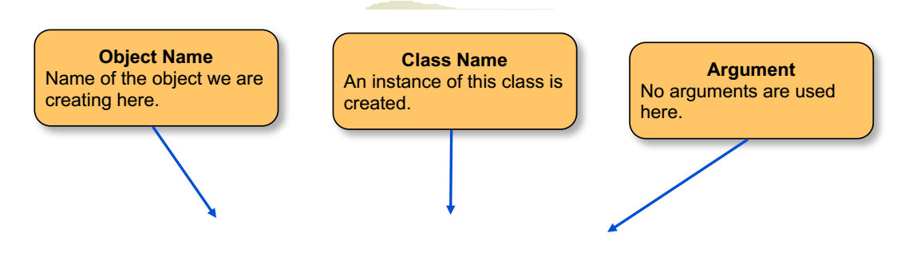
Object Creation
BA1= new BankAccount (……….);

Slide 21
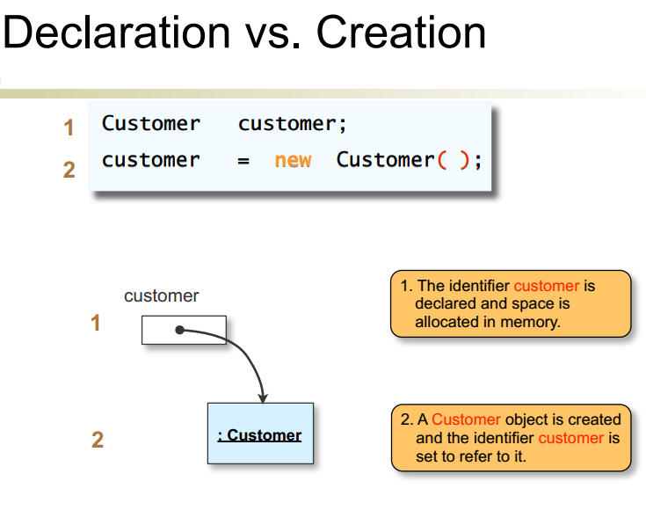

Slide 22
Properties of OOP
Encapsulation
Inheritance
Polymorphism

Slide 23
Inheritance
A class can inherit (extends) another class and its data members and methods.
The child class can redefine some of its parents class’s members and methods or/and add its own
Inheritance implements the “is a” relationship between objects
Without the use of hierarchies, each object would need to define all of its characters explicitly.
Super Class
Sub Class
Employee
Person
+Company : String
+Salary : Double
+Name : String
+Address : String
Sub Class
Student
+Dept : String
+ID : String

Slide 24
Polymorphism
Polymorphism is a Greek word
Poly means “many”, morphe means “shape,form”
Lets learn it by an example!
Ability to take more than one form
Polymorphism allows abstract operations to be defined and used.
Abstract operation defined in the base class’s interface and implemented in the subclass.

Slide 25
Polymorphism
Figure
Figure: CalculateArea(){
……………….
}
Square
Circle
Square: CalculateArea(){
return size * size ;
}
Circle: CalculateArea(){
return PI* radius * radius;
}

Slide 26
Polymorphism
Polymorphism ensures that the appropriate method is called for an object of a specific type when the object is disguised as a more generic type.
Figure f1= new Square();
Figure f2= new Circle();
int area1= f1. CalculateArea(); //this will call Square: CalculateArea()
int area2= f2. CalculateArea(); // this will call Circle: CalculateArea()

Slide 27
Encapsulation
To prevent uncontrolled access to read and modify the data for an object, OOP language restrict what operations (methods) can be applied to each object.
This restriction of behavior is also called encapsulation -- an important part of OOP.
The data and behavior are encapsulated.
This greatly improves reliability and manageability of code
Mechanism to bind together code and data it manipulates, keeps them both safe from outside interference and misuse

Slide 28
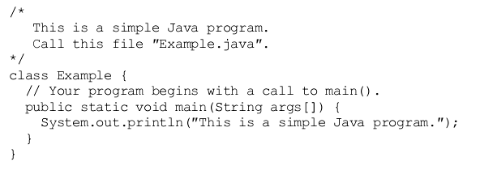
First Sample Program
Comment
Keyword

Slide 29
First Sample Program
Access Specifier
Ques: Why the main must be public??

Slide 30
First Sample Program
Keyword

Slide 31
Reference:
Herbert Schildt, “The Complete Reference”, 7th Edition, Tata McGraw Hill, 2002

